Slide 1
Recurrent Neural Networks (RNN)
Amos Azaria

Slide 2
Sequences
Bag of words loses relations between the words. The following bags are identical:
He likes bananas but not apples
He likes apples but not bananas
CNN is sometimes used also for text (1-dimentional).
Recurrent Neural Networks (RNN) is what we use for sequences.

Slide 3
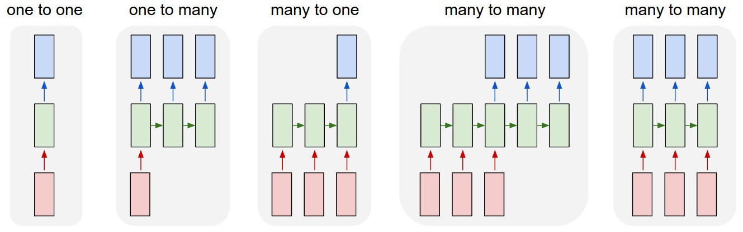
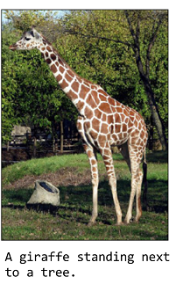
Sequence Types
E.g. Image to sentence
E.g. Video classification / sentiment analysis
E.g. Machine Translation (MT)
Automatic Speech Recognition (ASR)
Credit: http://karpathy.github.io/2015/05/21/rnn-effectiveness/

Slide 4
Fully Connected Layer for Sequences
Suppose we built a network that had a hidden layer with all neurons connected to each of the features of each of the elements in the sequence. (We will need to determine a maximal sequence length).
It would preserve sequence order, but would be very inefficient (way too many weights).
These weights learn redundant patterns.
We need weight sharing again!

Slide 5
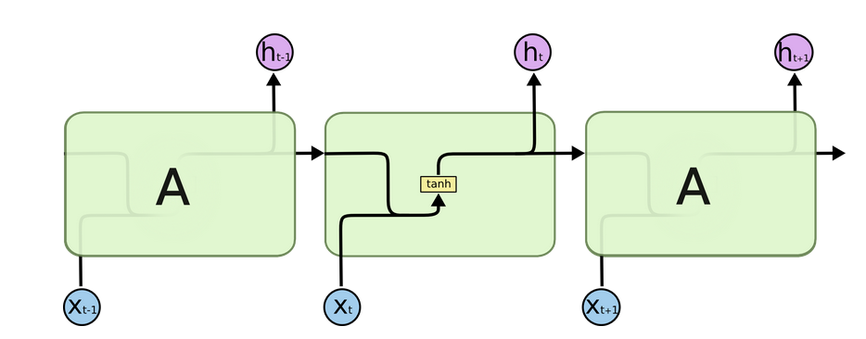
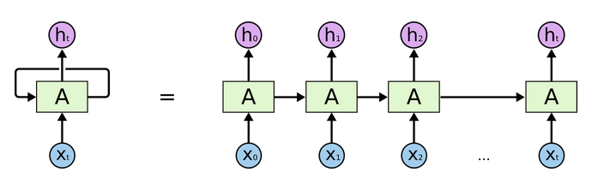
RNN
Credit: http://colah.github.io/posts/2015-08-Understanding-LSTMs/

Slide 6
Vanishing Gradient
Using a naïve implementation of RNN, actually results with a huge network.
Training such a network is nearly impossible as the gradients vanish (or explode), as we look at the earlier stages.
An output may depend on input received far back.

Slide 7
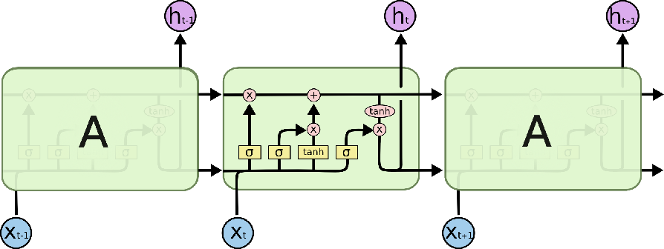
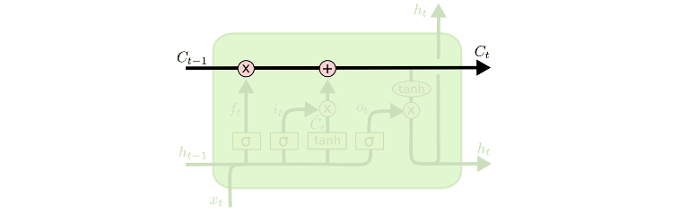
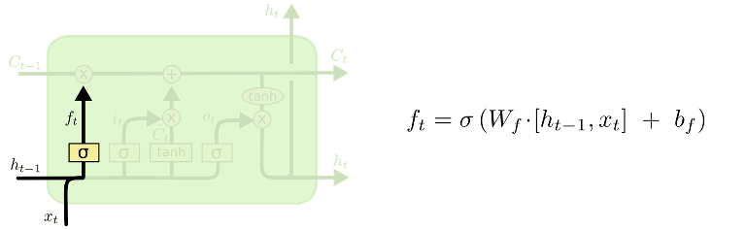
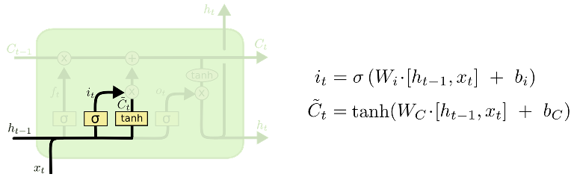
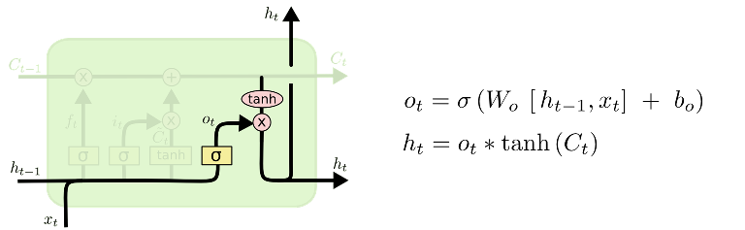
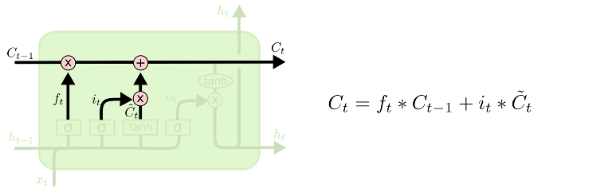
Long Short Term Memory (LSTM)
Output Gate:
Input Gate:
Whether to remember
Forget Gate:
Flow:
What to remember
A girl left, then an old man came, that person looked around.
Credit: http://colah.github.io/posts/2015-08-Understanding-LSTMs/
Notes:
\sigma is the sigmoid (logistic) function
1. A classifier that identifies what was the most recent gender when we reach the sentence end (.)
2. A classifier that identifies what is the gender of the word person (assume it is the most recent gender).

Slide 8
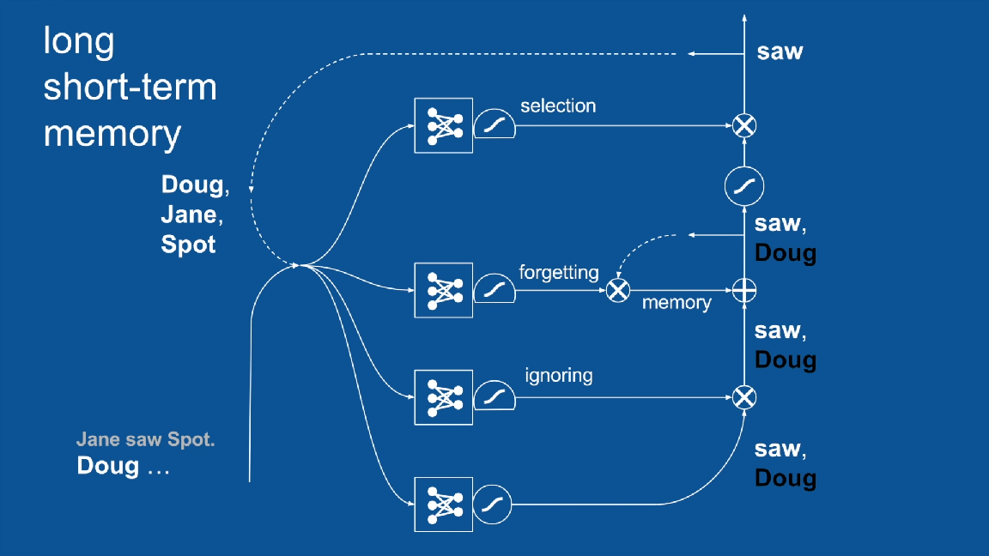
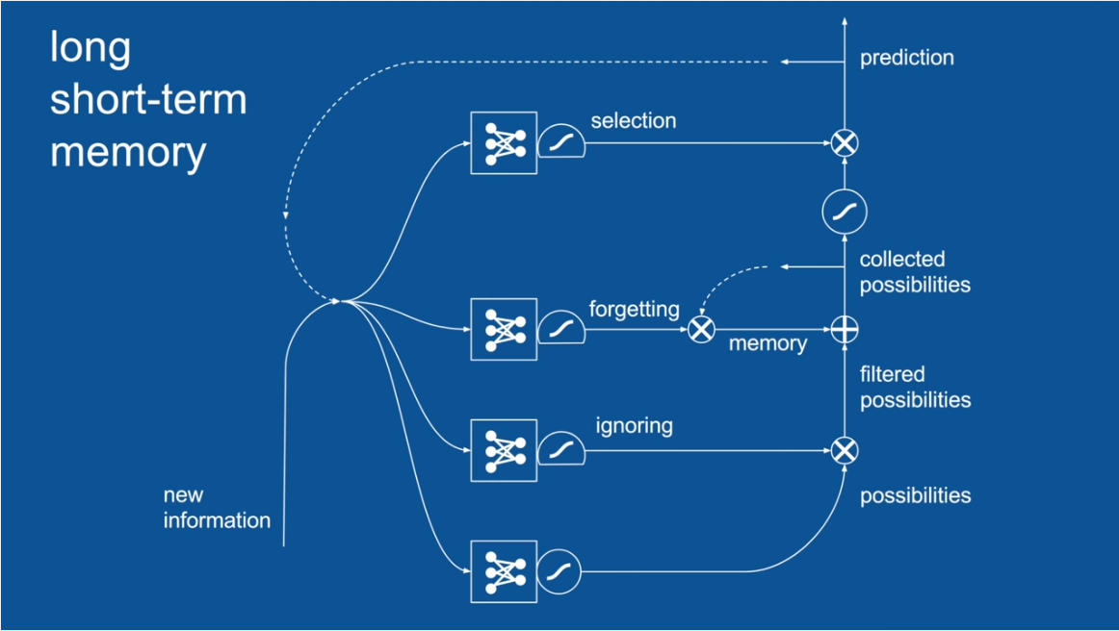
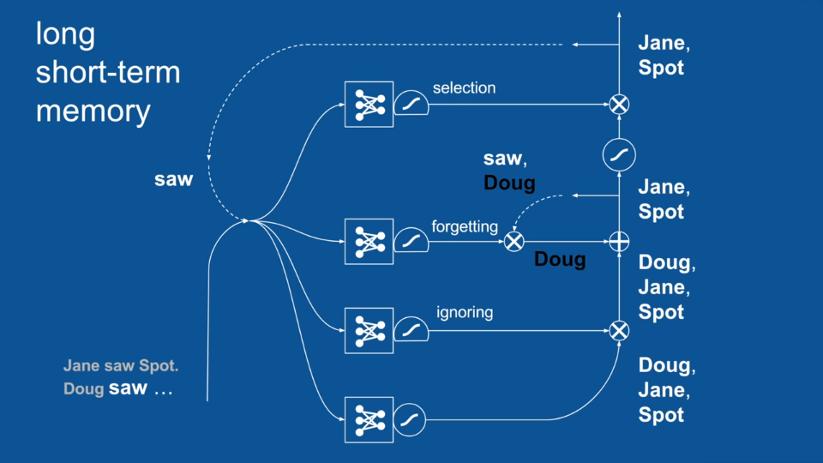
LSTM (a different view)
Credit: Brandon Rohrer's channel
https://www.youtube.com/watch?v=WCUNPb-5EYI

Slide 9
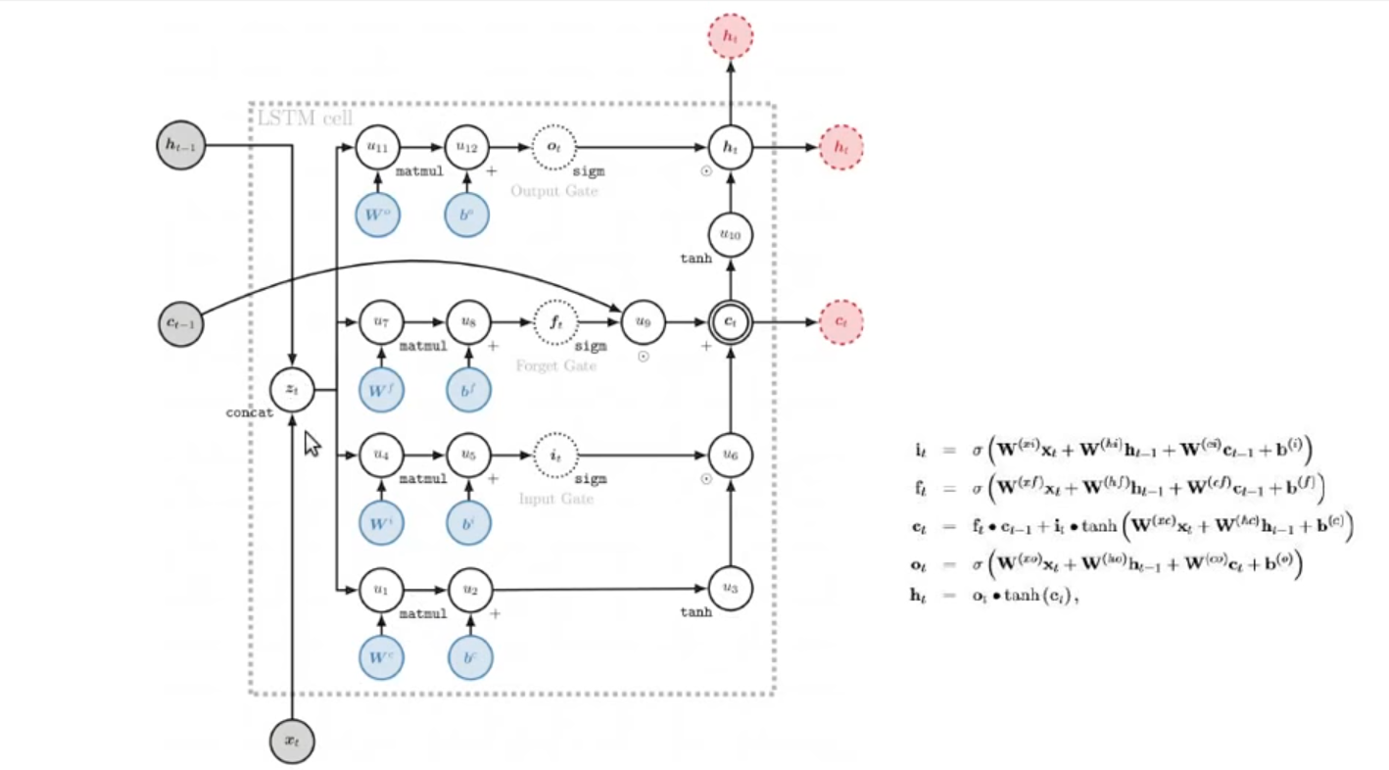
Yet Another Diagram…

Slide 10
How Many Weights (Parameters)?
Given the following LSTM level:
Input dimension: k
LSTM bandwidth (memory size): d
Maximum sequence length: T
Mini-batch size: m
How Many Weights (Parameters) does it have?
Do not memorize this formula. Understand it!
((k+d) + 1) * 4 * d
Not on the weights, but on the required RAM or GPU memory.
Do the maximum sequence length, and mini-batch size have any effect?

Slide 11
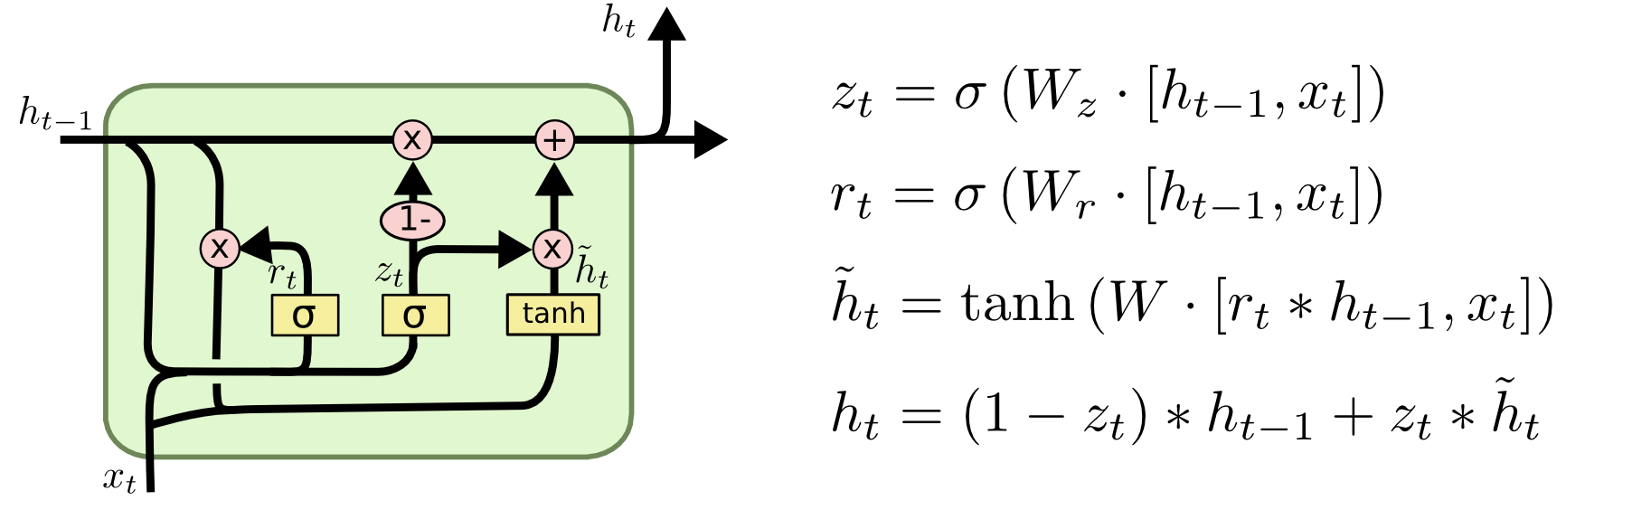
GRU
Credit: http://colah.github.io/posts/2015-08-Understanding-LSTMs/

Slide 12
Generating Text
We would like to write a program that will generate text (similar to some input test).
We have previously done so using n-grams.
We will now do so with LSTM – BUT (!) we will do so on the character level!
We start with declaring some preprocessing and post-processing functions.

Slide 13
Generating Text in TensorFlow (reading data +)
import tensorflow as tf
import numpy
import urllib
all_text = [ord(x) for x in list(urllib.urlopen("https://s3.amazonaws.com/text-datasets/nietzsche.txt").read().decode("utf-8"))]
batch_size = 15
num_past_characters = 10
step = 1
char_mapping = list(set(all_text)) #(e.g. ord(A), ord(a), ord(B), ord(b), ord(5), ...)
max_char = max(char_mapping)
possible_chars = len(char_mapping) #The number of options for characters equals 84
inverse_char_map = numpy.zeros(max_char+1, dtype=int)
for i in range(possible_chars):
inverse_char_map[char_mapping[i]] = i

Slide 14
Generating Text in TensorFlow (next batch in one-hot encoding)
num_input_examples = int((len(all_text)-(num_past_characters+1))/step)
curr_batch = 0
def next_batch(): #not that efficient. Can't save everything in memory, but maybe on disk?
global curr_batch
curr_range_start = curr_batch*batch_size
if curr_range_start + batch_size >= num_input_examples:
return (None, None)
data_x = numpy.zeros(shape=(batch_size,num_past_characters,possible_chars))
data_y = numpy.zeros(shape=(batch_size,possible_chars))
for ep in range(batch_size):
for inc in range(num_past_characters):
data_x[ep][inc][inverse_char_map[all_text[curr_range_start+ep*step+inc]]] = 1
data_y[ep][inverse_char_map[all_text[curr_range_start+ep*step+num_past_characters]]] = 1
curr_batch += 1
return (data_x, data_y)
def back_to_text(to_convert): # gets a one-hot encoded matrix and returns text. We'll need this at the end
return [chr(char_mapping[numpy.argmax(letter)]) for letter in to_convert]

Slide 15
Preprocessing Example
The "x" is a batch of 15 rows, each with 10 characters using a one-hot encoding (with 84 options)
>>> a = next_batch()
>>> a[0].shape
(15, 10, 84)
>>> a[1].shape
(15, 84)
>>> np.max(a[0])
1.0
>>> np.max(a[0],2)
array([[ 1., 1., 1., 1., 1., 1., 1., 1., 1., 1.],
[ 1., 1., 1., 1., 1., 1., 1., 1., 1., 1.],
[ 1., 1., 1., 1., 1., 1., 1., 1., 1., 1.],
[ 1., 1., 1., 1., 1., 1., 1., 1., 1., 1.],
[ 1., 1., 1., 1., 1., 1., 1., 1., 1., 1.],
[ 1., 1., 1., 1., 1., 1., 1., 1., 1., 1.],
[ 1., 1., 1., 1., 1., 1., 1., 1., 1., 1.],
[ 1., 1., 1., 1., 1., 1., 1., 1., 1., 1.],
[ 1., 1., 1., 1., 1., 1., 1., 1., 1., 1.],
[ 1., 1., 1., 1., 1., 1., 1., 1., 1., 1.],
[ 1., 1., 1., 1., 1., 1., 1., 1., 1., 1.],
[ 1., 1., 1., 1., 1., 1., 1., 1., 1., 1.],
[ 1., 1., 1., 1., 1., 1., 1., 1., 1., 1.],
[ 1., 1., 1., 1., 1., 1., 1., 1., 1., 1.],
[ 1., 1., 1., 1., 1., 1., 1., 1., 1., 1.]])
>>> np.argmax(a[0],2)
array([[47, 37, 42, 35, 5, 77, 65, 58, 77, 5],
[37, 42, 35, 5, 77, 65, 58, 77, 5, 48],
[42, 35, 5, 77, 65, 58, 77, 5, 48, 75],
[35, 5, 77, 65, 58, 77, 5, 48, 75, 78],
[ 5, 77, 65, 58, 77, 5, 48, 75, 78, 77],
[77, 65, 58, 77, 5, 48, 75, 78, 77, 65],
[65, 58, 77, 5, 48, 75, 78, 77, 65, 5],
[58, 77, 5, 48, 75, 78, 77, 65, 5, 66],
[77, 5, 48, 75, 78, 77, 65, 5, 66, 76],
[ 5, 48, 75, 78, 77, 65, 5, 66, 76, 5],
[48, 75, 78, 77, 65, 5, 66, 76, 5, 58],
[75, 78, 77, 65, 5, 66, 76, 5, 58, 5],
[78, 77, 65, 5, 66, 76, 5, 58, 5, 80],
[77, 65, 5, 66, 76, 5, 58, 5, 80, 72],
[65, 5, 66, 76, 5, 58, 5, 80, 72, 70]])
The "y_" is a batch of 15 rows, each a single "correct" characters using a one-hot encoding (with 84 options). This is actually the next character in the text.

Slide 16
Generating Text in TensorFlow (The Actual Graph!)
cellsize = 30
x = tf.placeholder(tf.float32, [None, num_past_characters, possible_chars])
y = tf.placeholder(tf.float32, [None, possible_chars])
lstm_cell = tf.nn.rnn_cell.BasicLSTMCell(cellsize, forget_bias=0.0)
output, _ = tf.nn.dynamic_rnn(lstm_cell, x, dtype=tf.float32)
output = tf.transpose(output, [1, 0, 2])
last = output[-1]
W = tf.Variable(tf.truncated_normal([cellsize, possible_chars], stddev=0.1))
b = tf.Variable(tf.constant(0.1, shape=[possible_chars]))
z = tf.matmul(last, W) + b
res = tf.nn.softmax(z)
cross_entropy = tf.reduce_mean(-tf.reduce_sum(y * tf.log(res), reduction_indices=[1]))
train_step = tf.train.GradientDescentOptimizer(0.1).minimize(cross_entropy)
We don't care about the LSTM (final) state
We are only interested in the LSTM last output !

Slide 17
Generating Text in TensorFlow (Training)
sess = tf.InteractiveSession()
sess.run(tf.global_variables_initializer())
correct_prediction = tf.equal(tf.argmax(y,1), tf.argmax(res,1))
accuracy = tf.reduce_mean(tf.cast(correct_prediction, tf.float32))
num_of_epochs = 100
for ephoch in range(num_of_epochs):
acc = 0
curr_batch = 0
while True:
batch_xs, batch_ys = next_batch()
if batch_xs is None:
break
else:
sess.run(train_step, feed_dict={x: batch_xs, y: batch_ys})
acc += accuracy.eval(feed_dict={x: batch_xs, y: batch_ys})
print("step %d, training accuracy %g"%(ephoch, acc/curr_batch))
Notes:
tf.InteractiveSession() is pretty much the same as tf.Session. The only difference is that tf.InteractiveSession() sets the current session as the default session, so one can call to a.eval() without providing the session, or call run without providing the session.

Slide 18
Generating Text in TensorFlow (Generating Text)
def text2arr(source, start):
src_as_num = [ord(x) for x in source]
ret_arr = numpy.zeros(shape=(1,num_past_characters,possible_chars))
for inc in range(num_past_characters):
ret_arr[0][inc][inverse_char_map[src_as_num[start+inc]]] = 1
return ret_arr
requested_length = 200
text = list("hello world")
for i in range(requested_length):
predicted_letter = back_to_text(res.eval(feed_dict={x:text2arr(text, len(text)-num_past_characters)}))
text += predicted_letter
print(''.join(text))

Slide 19
Results
After 1 epoch on 1% of the data:
After 1 epoch on 10% of the data:
an the the the the the the the the the the the the the the the the the the the the the the the the the the the the the the the the the the the the the the the the the the the the the the the the the
After 1 epoch on all data:
"the somes and the somes and the somes and the somes and the somes and the somes and the somes and the somes and the somes and the somes and the somes and the somes and the somes and the somes and the"
After 100 epochs (2 hours with a strong GPU):
"of him to an incurent, with the moral fad and definition, the most still of his notwourses himself of the sense of the most still of his notwourses himself of the sense of the most still of"

Slide 20
Questions
Why did we get this repetition pattern?
How could we avoid the repetition?
Increase num_past_characters?
Instead of using argmax, we should sample according to the probabilities
Notes:
Why are there no periods?
Increasing num_past_characters might still have repetition but of longer text

Slide 21
tf.nn.rnn_cell.BasicLSTMCell (deprecated)
tf.nn.rnn_cell.BasicLSTMCell.__init__(num_units, forget_bias=1.0, state_is_tuple=True, activation=tanh)
Args:
num_units: int, The number of units in the LSTM cell.
forget_bias: float, The bias added to forget gates (We add forget_bias (default: 1) to the biases of the forget gate in order to reduce the scale of forgetting in the beginning of the training.).
state_is_tuple: If True, accepted and returned states are 2-tuples of the c_state and m_state. If False, they are concatenated along the column axis. The latter behavior will soon be deprecated.
activation: Activation function of the inner states.
"Importantly, adding a bias of size 1 significantly improved the performance of the LSTM on tasks where it fell behind the GRU" (An Empirical Exploration of Recurrent Network Architectures, 2015)
Notes:
Note that this cell is not optimized for performance. Please use tf.contrib.cudnn_rnn.CudnnLSTM for better performance on GPU, or tf.contrib.rnn.LSTMBlockCell and tf.contrib.rnn.LSTMBlockFusedCell for better performance on CPU.

Slide 22
tf.nn.rnn_cell.LSTMCell
The LSTMCell (as opposed to BasicLSTMCell) has many features (such as peep-hole), take a look!
Use tf.contrib.cudnn_rnn.CudnnLSTM() for better performance on GPU.

Slide 23
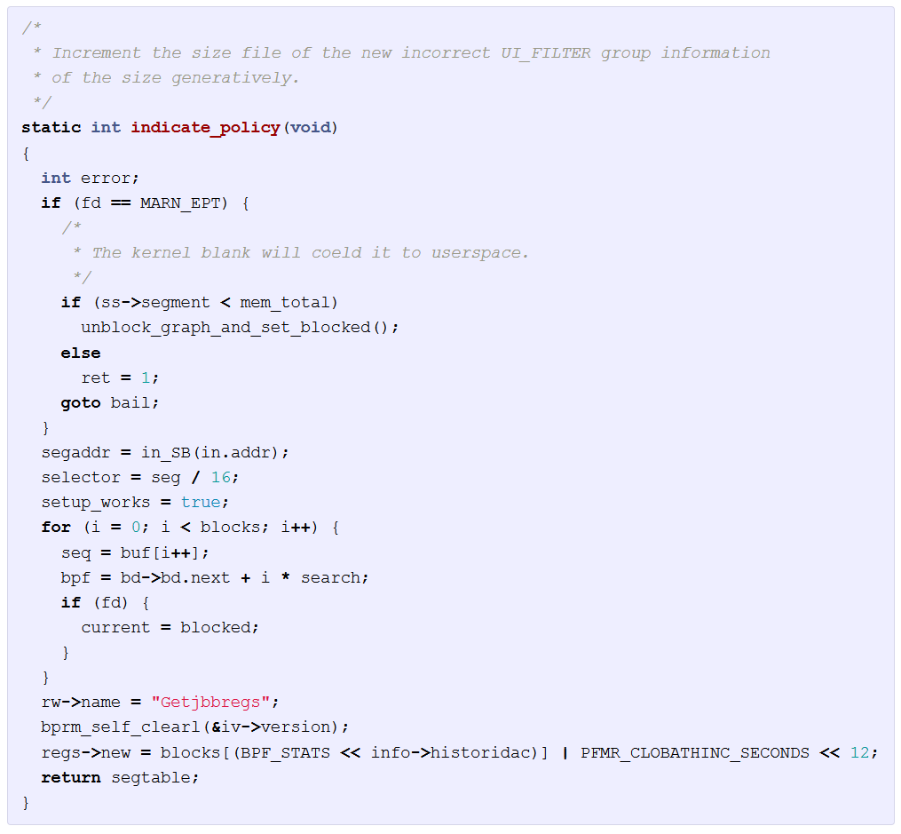
Linux Source-Code
Credit: http://karpathy.github.io/2015/05/21/rnn-effectiveness

Slide 24
Additional RNN Layer(s)
Having more than a single RNN layer is simple:
We replace:
lstm_cell = tf.nn.rnn_cell.BasicLSTMCell(cellsize, forget_bias=0.0)
output, _ = tf.nn.dynamic_rnn(lstm_cell, x, dtype=tf.float32)
With the following:
lstm_cell = tf.nn.rnn_cell.BasicLSTMCell(cellsize, forget_bias=0.0)
# Or GRUCell (num_hidden)
dopoutRNN = tf.nn.rnn_cell.DropoutWrapper(lstm_cell , output_keep_prob=dropout) #Easily add a dropout layer in-between
multiRNN = rnn_cell.MultiRNNCell([dopoutRNN ] * num_layers)
output, _ = tf.nn.dynamic_rnn(multiRNN, x, dtype=tf.float32)
What does dropout on LSTM actually mean?
This mistake appears in many places in the internet, so beware!

Slide 25
Why Doesn't it Work?
>>> ["hi"] * 4
['hi', 'hi', 'hi', 'hi']
>>> a = ["hi"] * 4
>>> a[0] = "hello"
>>> a
['hello', 'hi', 'hi', 'hi']
>>> b = [{"hi": "hello"}]*4
>>> b
[{'hi': 'hello'}, {'hi': 'hello'}, {'hi': 'hello'}, {'hi': 'hello'}]
>>> b[0]['hi'] = 'bye'
>>> b
[{'hi': 'bye'}, {'hi': 'bye'}, {'hi': 'bye'}, {'hi': 'bye'}]
>>> c = [["hi"]] * 4
>>> c[0].append('hello')
>>> c
[['hi', 'hello'], ['hi', 'hello'], ['hi', 'hello'], ['hi', 'hello']]

Slide 26
What is the Solution? (creating multiple objects)
>>> d = [["hi"] for _ in range(4)]
>>> d
[['hi'], ['hi'], ['hi'], ['hi']]
>>> d[0].append('hello')
>>> d
[['hi', 'hello'], ['hi'], ['hi'], ['hi']]

Slide 27
Multiple RNN Layers
First option:
rnn_cell.MultiRNNCell([tf.nn.rnn_cell.DropoutWrapper(tf.nn.rnn_cell.BasicLSTMCell(cellsize) , output_keep_prob=dropout) for _ in num_layers])
Better practice is to use a function that returns:
def get_lstm_dropout(cellsize, dropout):
lstm_cell = tf.nn.rnn_cell.BasicLSTMCell(cellsize, forget_bias=1.0)
dopoutRNN = tf.nn.rnn_cell.DropoutWrapper(lstm_cell , output_keep_prob=dropout)
return dropoutRNN
And then call it:
rnn_cell.MultiRNNCell([get_lstm_dropout(mem_size, dropout) for mem_size in [120, 70, 50]])

Slide 28
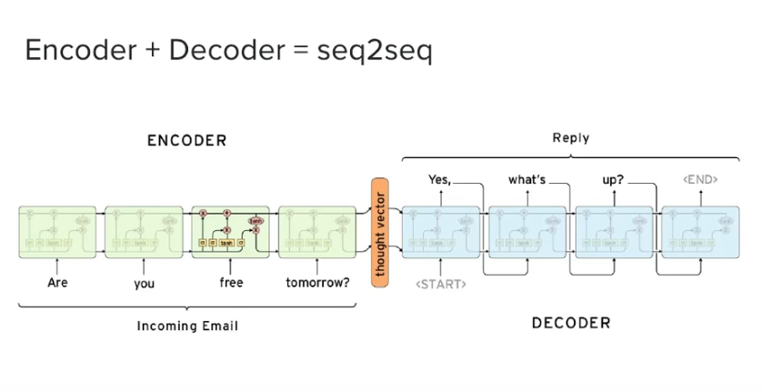
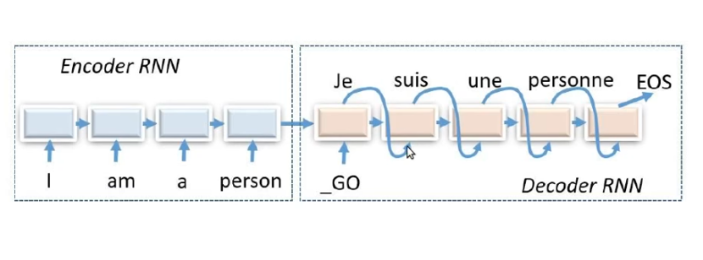
Machine Translation
Attention Mechanisms in Recurrent Neural Networks (RNNs) - IGGG

Slide 29
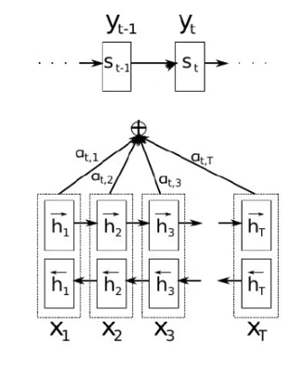


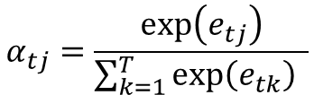
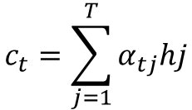
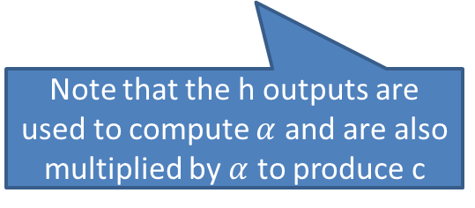


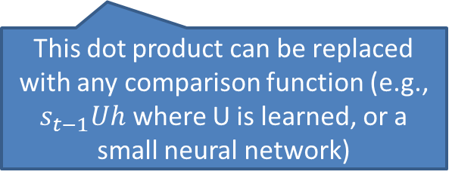


Attention
$$c_{t}=\sum_{j=1}^{T}{α_{tj}hj}$$
$$c_{t}$$
$$e_{tj}=s_{t−1}⋅h_{j}$$
attention
$$α_{t,1}$$
$$α_{t,4}$$
This dot product can be replaced with any comparison function (e.g., $s_{t−1}Uh$ where U is learned, or a small neural network)
$$α_{t,2}$$
$$α_{t,3}$$
$$α_{tj}=\frac{\exp\left(e_{tj}\right)}{\sum_{k=1}^{T}{\exp\left(e_{tk}\right)} }$$
Note how many alphas must be computed! (quadratic)
Note that the h outputs are used to compute $α$ and are also multiplied by $α$ to produce c
Notes:
The paper: Neural Machine Translation by Jointly Learning to Align and Translate ICLR 2015 https://arxiv.org/pdf/1409.0473.pdf
$s_{t}=f(s_{t−1},y_{t−1},c_{t})$
Also see here (Andrew Ng): https://www.youtube.com/watch?v=FMXUkEbjf9k
I saw in some blog that they replaced etj with a linear combination of st-1 and hj – however, this will not work! We need at least one hidden layer so that the features may relate to each-other.

Slide 30
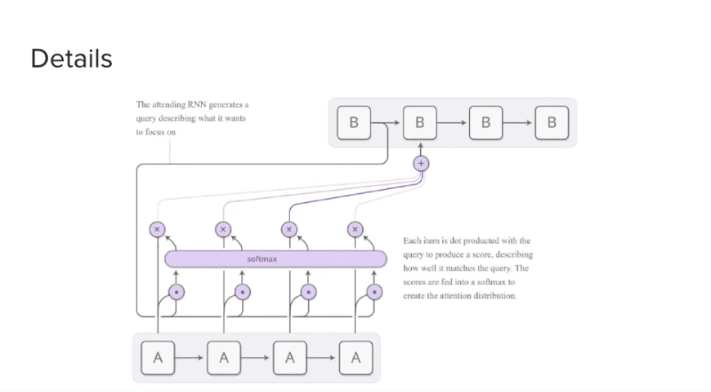
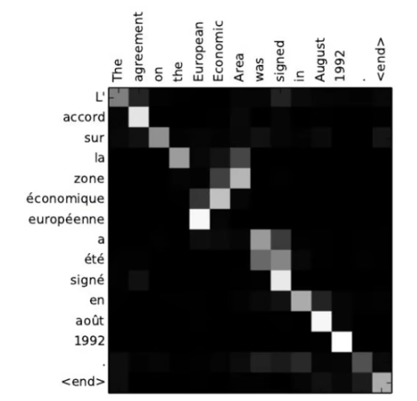
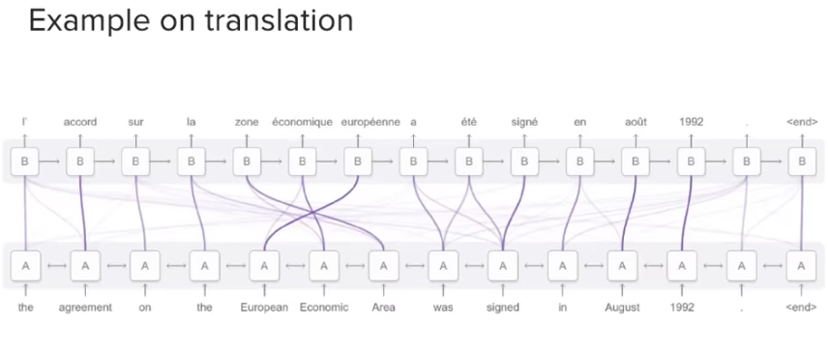
Attention
Attention Mechanisms in Recurrent Neural Networks (RNNs) - IGGG

Slide 31
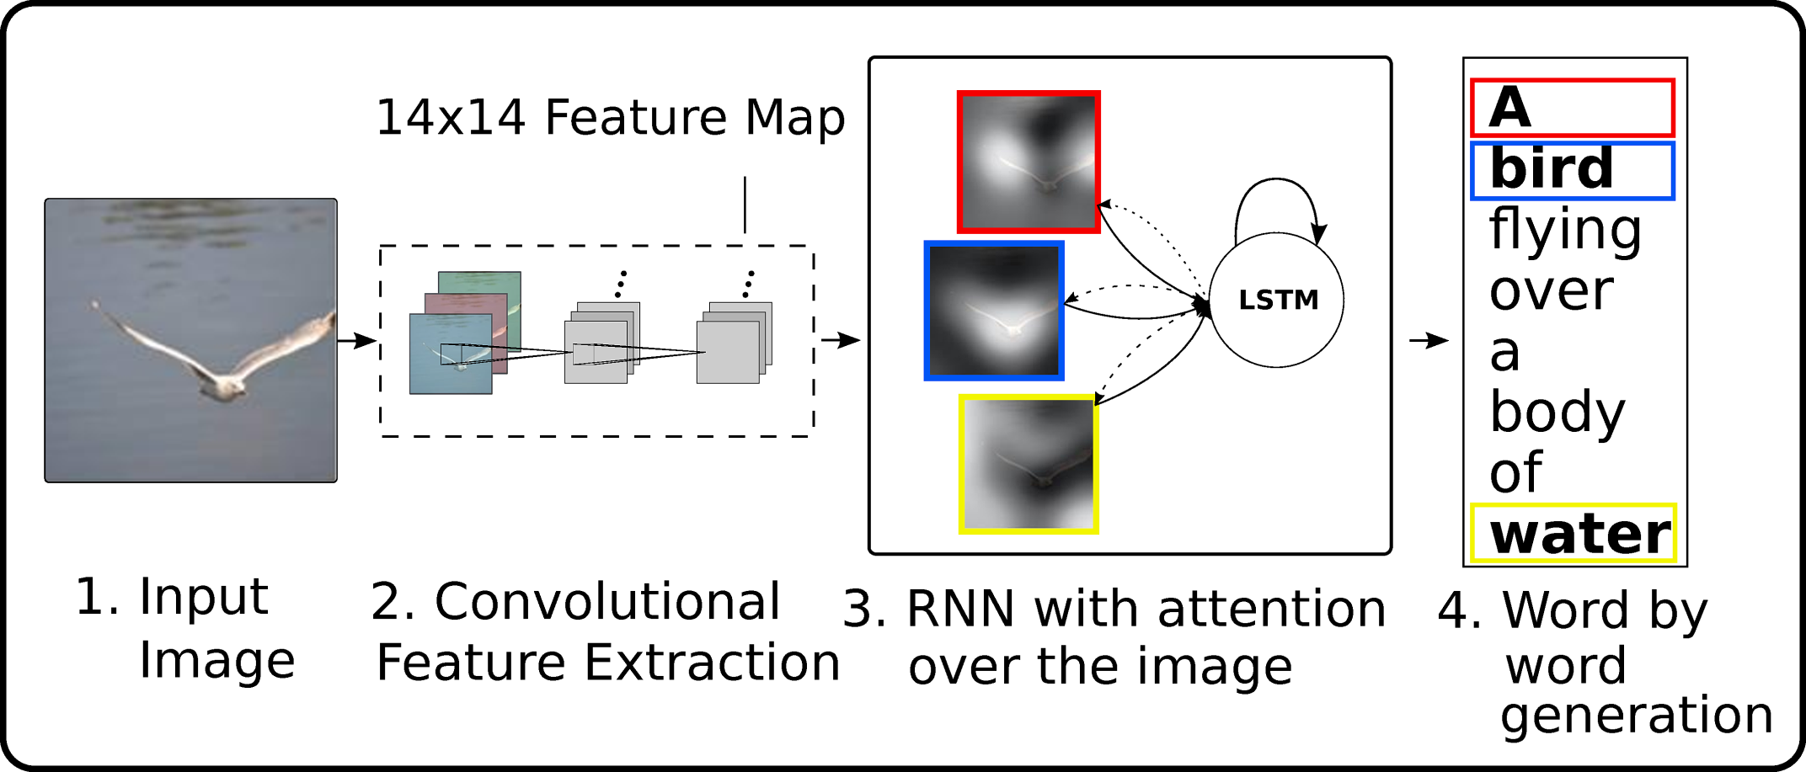
Attention in Images
From paper: Show, attend and tell: Neural image caption generation with visual attention (2015)

Slide 32
BLEU (Bilingual Evaluation Understudy) Score
Sums the number of times each n-gram from the candidate appears in the reference.
If an n-gram appears several times, it cannot be credited for more than it appears in the reference.
The BLEU is this number divided by the number of n-grams in the candidate.
This average BLEU score is multiplied by a regulator that penalizes short sentences: (e^{(1-r/c)}), r is the total length of all the reference sentences, c is the total length of all the candidates (applied only when c<r).
Usually uses 4-grams
Unigram example:
Candidate | His | dog | is | big | big
Reference | I | saw | a | big | dog
2/5

